Slide 1
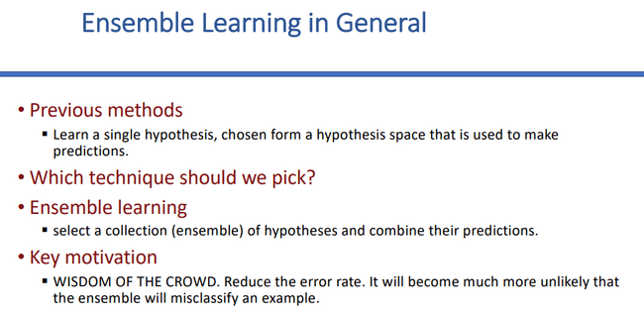


Ensemble Learning is a machine learning technique where multiple models are combined to improve overall performance. It uses multiple learning algorithms to obtain better predictive performance.

Slide 2
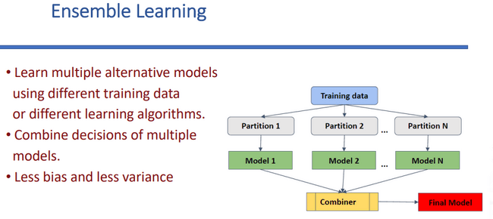


Improve accuracy, Robustness, Reduce bias and variance
Training Dataset re randomly choise kre onkgula sub data set e vag
Prottek data set re ek ekta model dara train kre ek ek ta output pai
Classification er jnne- sob thke besi model jei output dbe seitai final output;
Regression er jnne- sob model er output er average hbe final output.

Slide 3
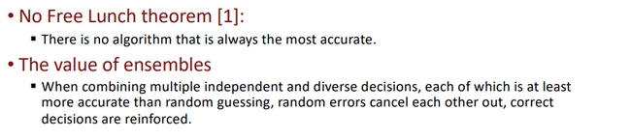

Slide 4
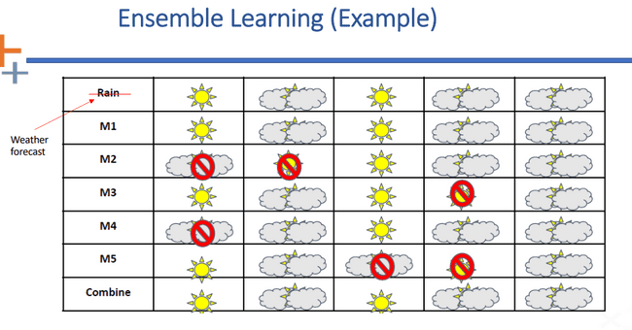

Besirbag model thke sunny paisi tai final output combine kre sunny e
Besirbag model thke cloudy paisi tai final output combine kre cloudy e

Slide 5
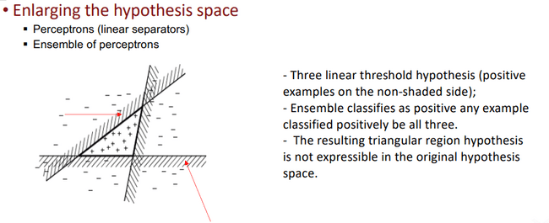

Slide 6
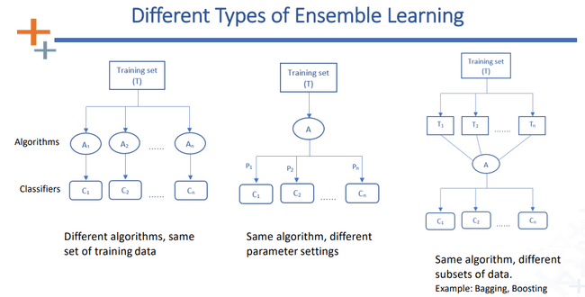


Slide 7
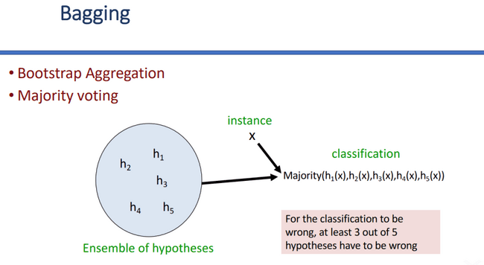

Slide 8
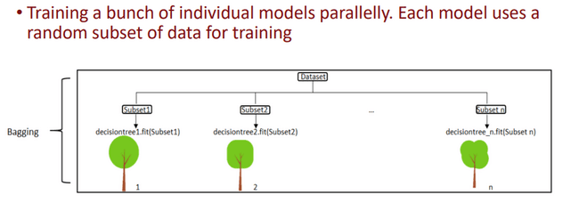

Slide 9
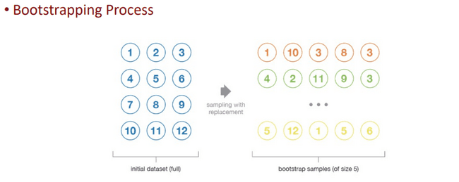

Slide 10

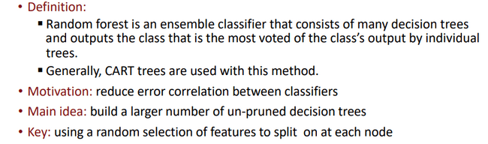


A Random Forest is an ensemble learning method that creates many decision trees during training and outputs the majority vote (for classification) or average prediction (for regression) of those trees to improve accuracy and reduce overfitting.
Classification and Regresiion trees
Motivation: Reduce overfitting and improve accuracy.
Main Idea: Build many decision trees and combine their results.
Key: Random sampling of data and features; final prediction by voting/averaging.

Slide 11
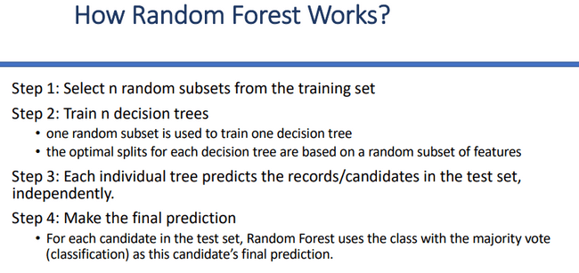



Slide 12
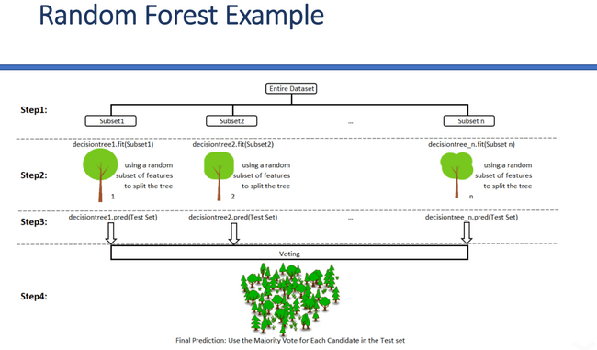

Slide 13
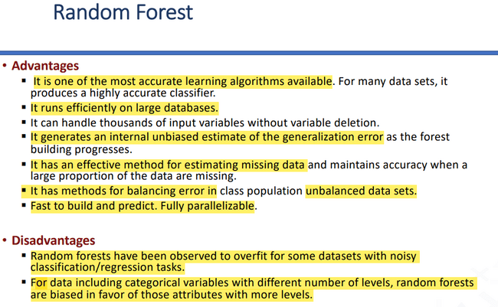
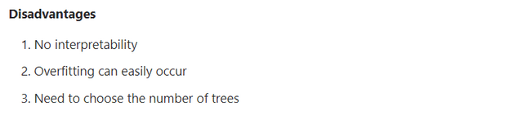


Advantages of Random Forest:
* High accuracy and robust performance
* Reduces overfitting compared to a single decision tree
* Works well with both classification and regression
* Handles large datasets and high-dimensional data well
* Less sensitive to noise and outliers
### **Disadvantages of Random Forest:**
* More computationally expensive and slower than a single tree
* Harder to interpret (less explainable)
* Requires more memory due to many trees
* Training time can be long for large datasets

Slide 14
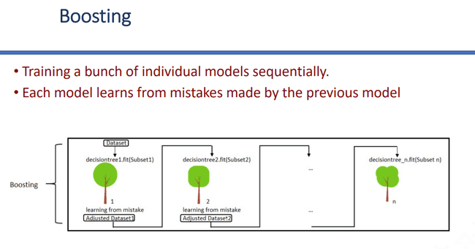

Slide 15
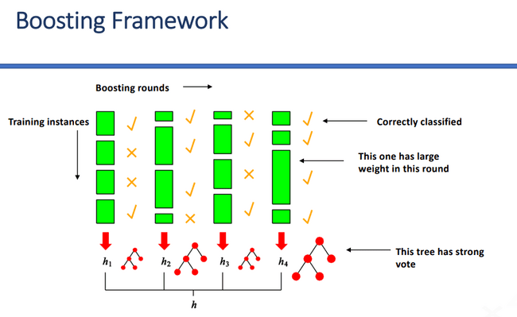

Slide 16
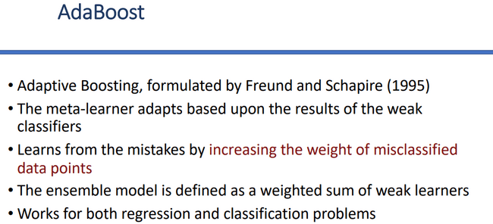

Bagging : Reduce variance by averaging multiple model, training approach parallel, equal weighting for all samples, improve stability and reduce overfitting
Boosting: reduce both variance and bias by focusing on hard to predict examples, train approach is sequential, adjust weight-increase weight for misclassified samples, improves accuracy

Slide 17
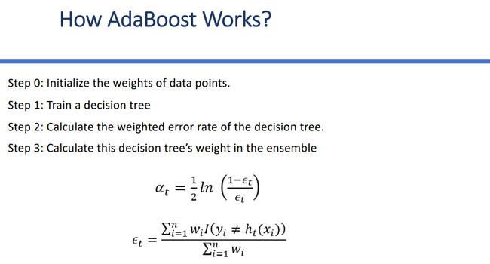

Slide 18
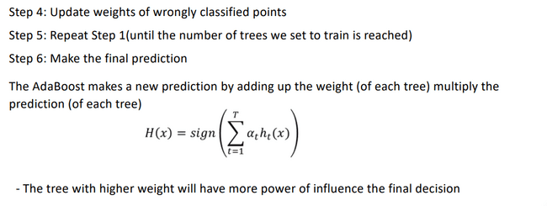

Slide 19
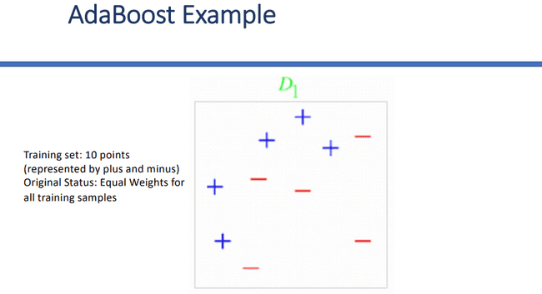

Slide 20
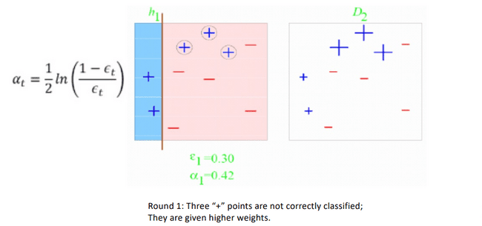

Slide 21
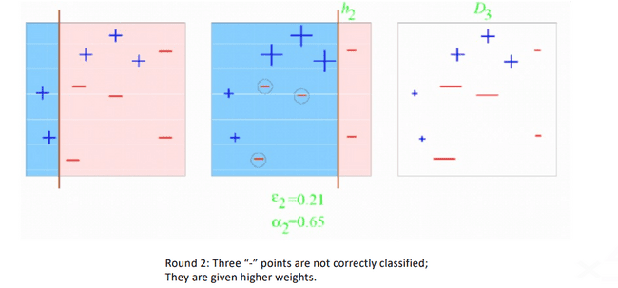

Slide 22
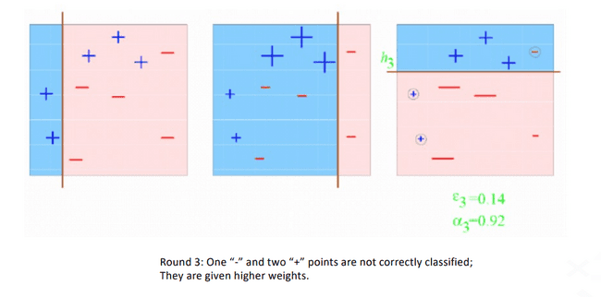

Slide 23
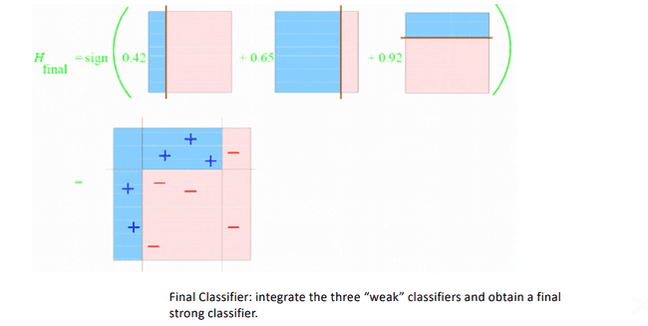

Slide 24
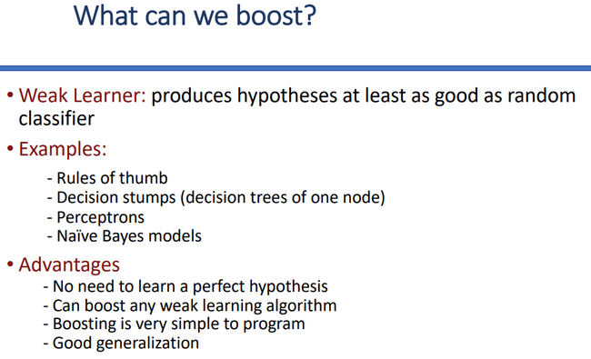



A weak learner is defined as an algorithm that produces hypotheses that are at least slightly better than a random classifier.
Why Use Boosting?
Boosting is a popular technique because it offers several distinct advantages:
Efficiency: There is no need to learn a perfect hypothesis from the start.
Flexibility: You can boost almost any weak learning algorithm.
Ease of Use: Boosting algorithms are generally simple to program.
Reliability: It provides good generalization, meaning the final model usually performs well on new, unseen data.

Slide 25
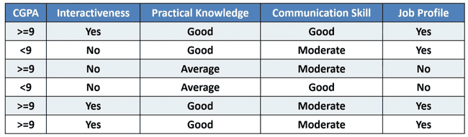

Slide 26
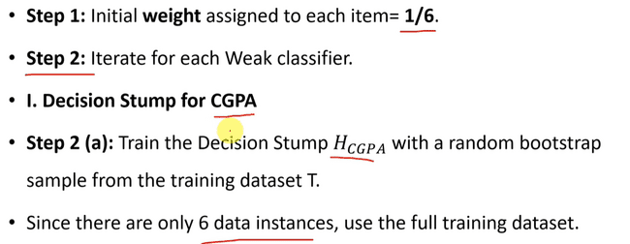

Slide 27
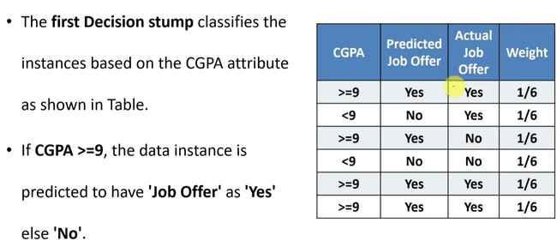

Slide 28
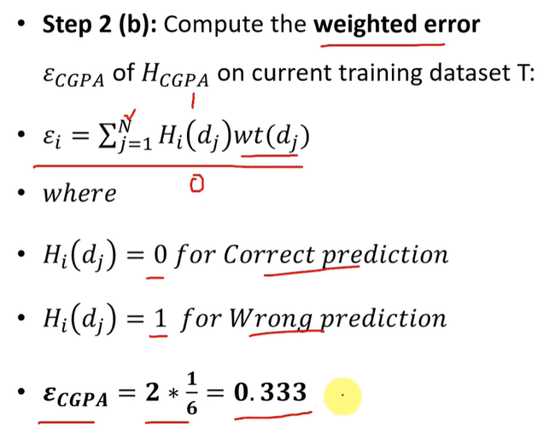
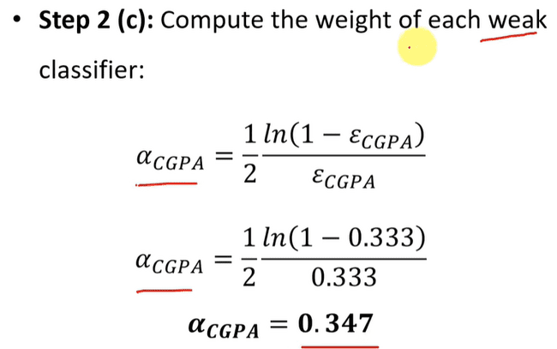

Slide 29
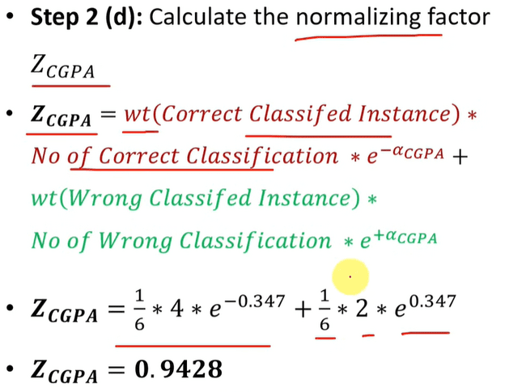

Slide 30
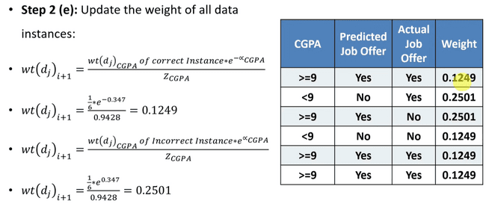

Slide 31
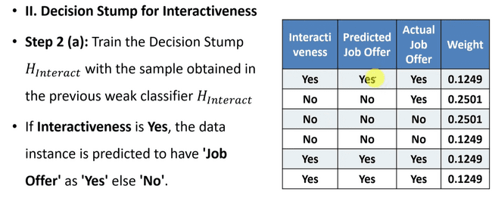

Slide 32
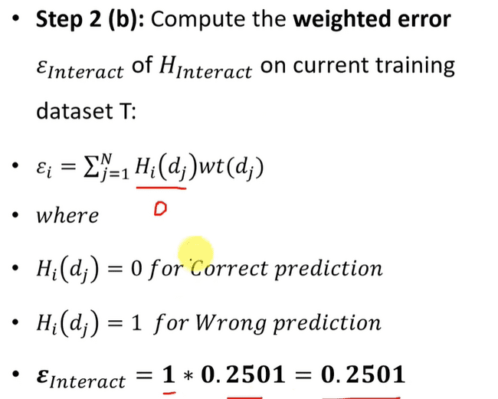
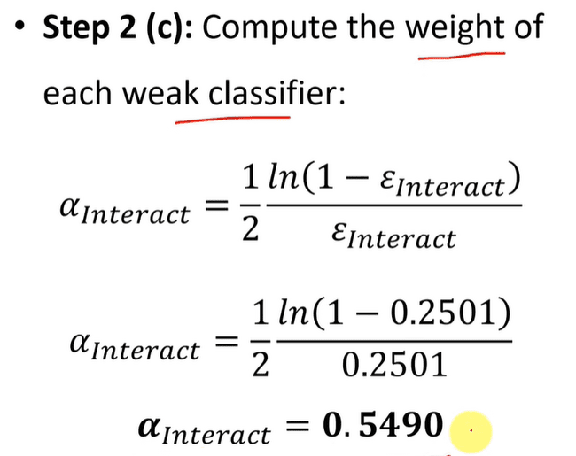

Slide 33
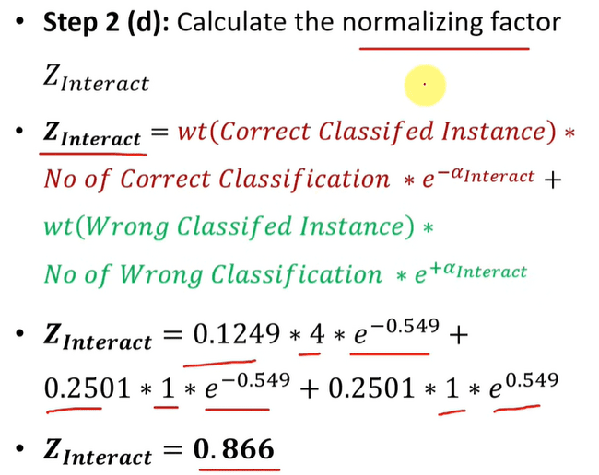

Slide 34
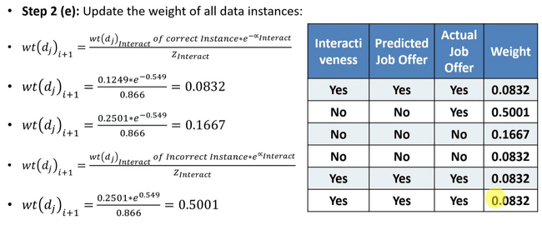

Slide 35
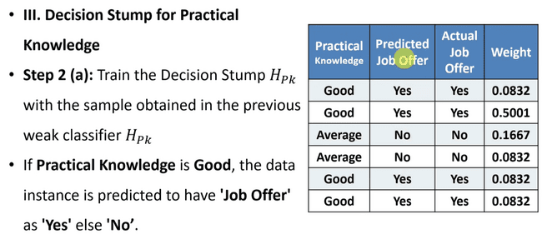

Slide 36
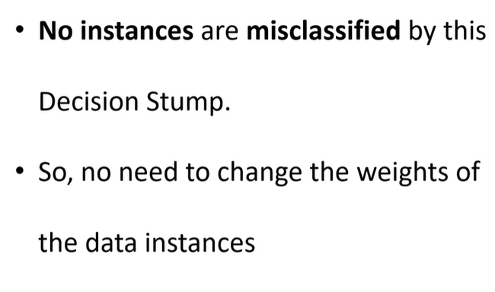

Slide 37
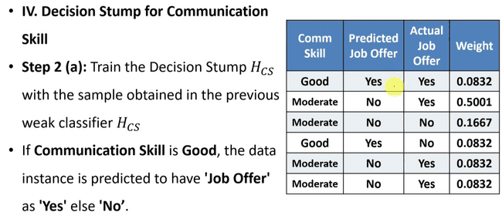

Slide 38
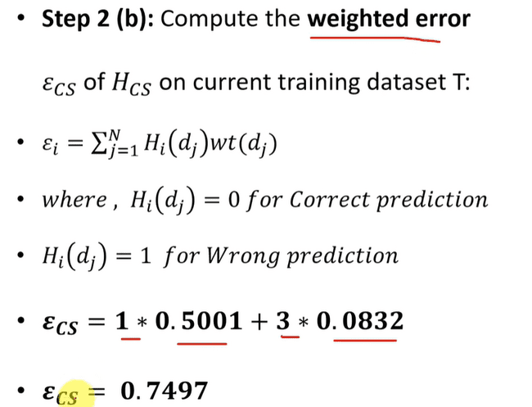
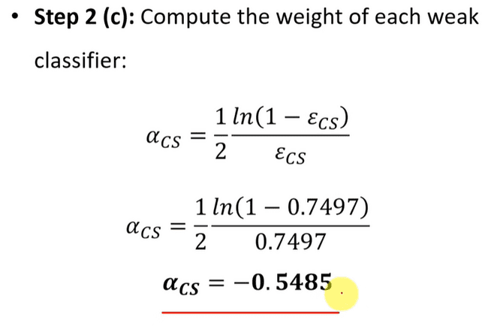

Slide 39
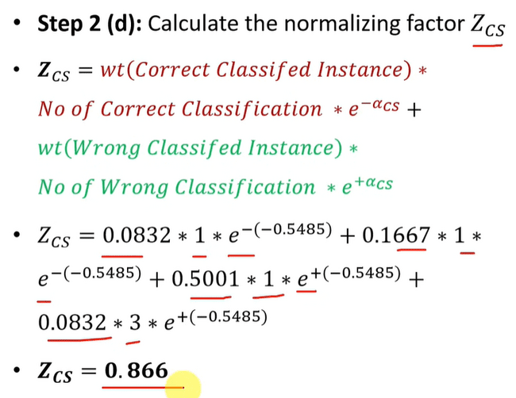

Slide 40
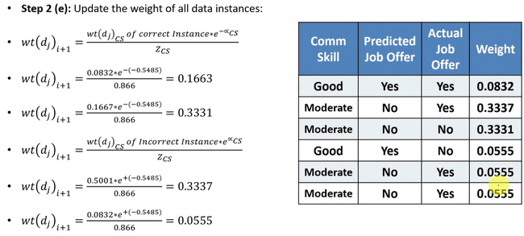

Slide 41
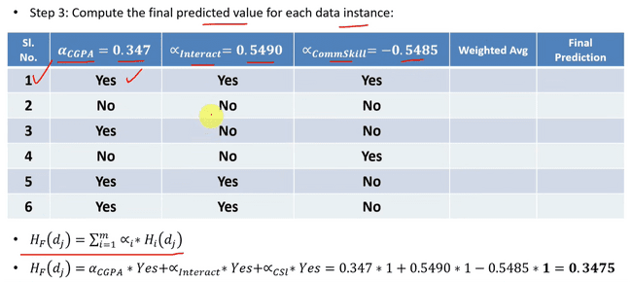

Slide 42
